Slide 1


Gunawan
28 October 2022

Slide 2

Outline
Executive Summary
Introduction
Methodology
Results
Conclusion
Appendix

Slide 3
Executive Summary
Methodologies to analyze data
Data Collection using web scraping and SpaceX API; data wrangling
Exploratory Data Analysis (EDA) for data visualization and interactive dashboard
Machine Learning Prediction.
Summary of all results
EDA is a useful method to identify which features best predict launch success;
Machine Learning Prediction shows the best model to predict which characteristics are important to predict the launch success.

Slide 4
Introduction
Project background and context
Space X advertises Falcon 9 rocket launches on its website with a cost of 62 million dollars; other providers cost upward of 165 million dollars each, much of the savings is because Space X can reuse the first stage. Therefore, if we can determine if the first stage will land, we can determine the cost of a launch. This information can be used if an alternate company wants to bid against space X for a rocket launch. The project is aimed to predict if the Falcon 9 first stage will land successfully.
Problems:
What factors determine if the rocket will land successfully?
The interaction amongst various features that determine the success rate of a successful landing.
What operating conditions needs to be in place to ensure a successful landing program.

Slide 5

Section 1

Slide 6
Methodology
Executive Summary
Data was collected using SpaceX API and web scraping from Wikipedia.
Perform data wrangling
summarizing and analyzing features
creating a landing outcome label based on outcome data
Perform exploratory data analysis (EDA) using visualization and SQL
Perform interactive visual analytics using Folium and Plotly Dash
The predictive analysis was performed using classification models, which are decision tree, K-Neighbors, Logistic regression and support vector machine.

Slide 7
Data Collection
Data sets were collected from
Space X API (https://api.spacexdata.com/v4/rockets/)
Wikipedia (https://en.wikipedia.org/wiki/List_of_Falcon/_9/_and_Falcon_Heavy_launches)

Slide 8
Data Collection – SpaceX API
The process of collecting data using the API is presented in a flowchart.
The SpaceX API notebook is stored on the GitHub with this link:
https://github.com/unyil01/edx-IBM-capstone/blob/main/01%20Data%20Collection%20API.ipynb
Request API and parse the SpaceX launch data
Filter data to only
include Falcon 9 launches
Handling missing values

Slide 9
Data Collection - Scraping
Data are scrapped from Wikipedia followed the process as outlined in the flowchart
The notebook is stored on the GitHub with this link:
https://github.com/unyil01/edx-IBM-capstone/blob/main/02%20Data%20Collection%20with%20Web%20Scraping.ipynb
Request the Falcon9
Launch Wiki page
Extract all column/variable
names from the HTML
table header
Create a data frame by
parsing the launch HTML
tables

Slide 10
Data Wrangling
EDA was performed and training labels were determined.
The number of launches at each site, and the number and occurrence of each orbits were calculated
Landing outcome label from outcome column was made. The result was exported to csv.
The notebook is stored on the GitHub with this link:
https://github.com/unyil01/edx-IBM-capstone/blob/main/03%20Data%20Wrangling.ipynb
Exploratory Data Analysis
Summarizing
Create of landing outcome lable

Slide 11
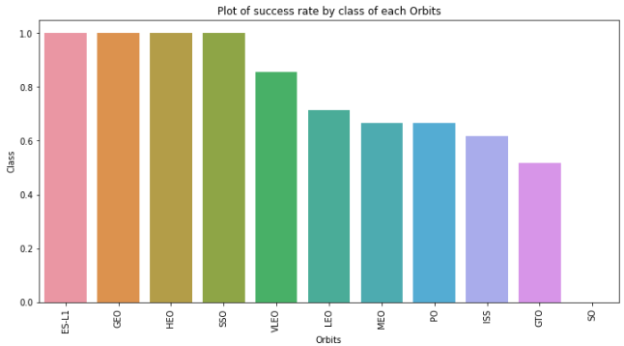
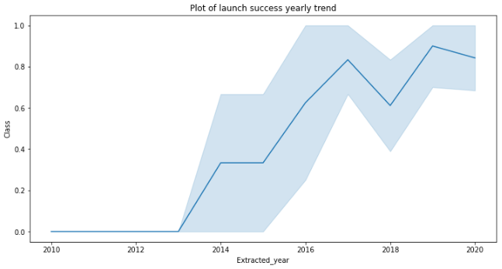
EDA with Data Visualization
Data visualization was performed by visualizing the relationship between flight number and launch Site, payload and launch site, success rate of each orbit type, flight number and orbit type, the launch success yearly trend.
Here is the notebook link on GitHub: https://github.com/unyil01/edx-IBM-capstone/blob/main/05%20EDA%20with%20Data%20Visualization.ipynb

Slide 12
EDA with SQL
The SpaceX dataset was exported into a PostgreSQL database.
EDA with SQL was implemented to get insight from the data. The queries were constructed:
The names of unique launch sites in the space mission.
The total payload mass carried by boosters launched by NASA (CRS)
The average payload mass carried by booster version F9 v1.1
The total number of successful and failure mission outcomes
The failed landing outcomes in drone ship, their booster version and launch site names.
Here is the link of the notebook https://github.com/unyil01/edx-IBM-capstone/blob/main/04%20EDA%20with%20SQL.ipynb

Slide 13
Build an Interactive Map with Folium
Markers indicate points like launch sites; Circles indicate highlighted areas around specific coordinates, like NASA Johnson Space Center; Marker clusters indicates groups of events in each coordinate, like launches in a launch site; Lines are used to indicate distances between two coordinates.
The feature launch outcomes (failure or success) were transformed into class 0 and 1.i.e., 0 for failure, and 1 for success.
Using the color-labeled marker clusters, we identified which launch sites have relatively high success rate.
The distances between a launch site to its proximities were computed for answering such questions:
Are launch sites near railways, highways and coastlines.
Do launch sites keep certain distance away from cities.
The notebook link is https://github.com/unyil01/edx-IBM-capstone/blob/main/06%20Interactive%20Visual%20Analytics%20with%20Folium.ipynb

Slide 14
Build a Dashboard with Plotly Dash
Creating an interactive dashboard with Plotly dash
Plotting pie charts presenting the total launches by a certain sites
Plotting scatter graph showing the relationship with Outcome and Payload Mass (Kg) for the different booster version.
The link to the notebook is
https://github.com/unyil01/edx-IBM-capstone/blob/main/07%20spacex_dash_app.py

Slide 15
Predictive Analysis (Classification)
Loading the data using numpy and pandas, transformed the data, split our data into training and testing.
Building different machine learning models and tune different hyperparameters using GridSearchCV.
Using accuracy as the metric for our model, improving the model using feature engineering and algorithm tuning.
Selecting the best performing classification model.
Here is the link to the notebook
https://github.com/unyil01/edx-IBM-capstone/blob/main/08%20Machine%20Learning%20Prediction.ipynb

Slide 16
Results
Exploratory data analysis results:
• Space X uses 4 different launch sites;
• The first launches were done to Space Xitself and NASA;
• The average payload of F9 v1.1 booster is 2,928 kg;
• The first success landing outcome happened in 2015 fiver year after the first launch;
• Many Falcon 9 booster versions were successful at landing in drone ships having payload above the average;
• Almost 100% of mission outcomes were successful;
• Two booster versions failed at landing in drone ships in 2015: F9 v1.1 B1012 and F9 v1.1 B1015;
• The number of landing outcomes became as better as years passed.

Slide 17
Results
Interactive analytics demo in screenshots
Using interactive analytics was possible to identify that launch sites use to be in safety places, near sea, for example and have a good logistic infrastructure around.
Most launches happens at east cost launch sites.

Slide 18
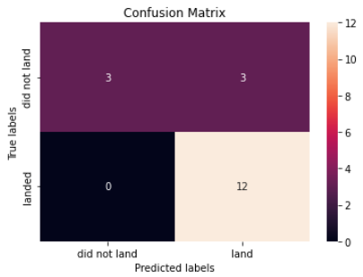
Results
Predictive Analysis showed that Decision Tree Classifier is the best model to predict successful landings, having accuracy over 87% and accuracy for test data over 94%.

Slide 19

Section 2

Slide 20
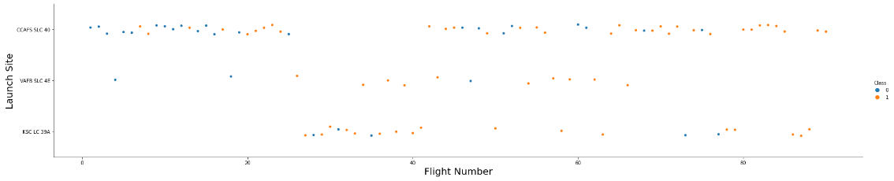
Flight Number vs. Launch Site
The plot indicates that the larger the flight amount at a launch site, the greater the success rate at a launch site.
According to the plot above, it’s possible to verify that the best launch site nowadays is CCAF5 SLC 40, where most of recent launches were successful;
In second place VAFB SLC 4E and third place KSC LC 39A;
It’s also possible to see that the general success rate improved over time.

Slide 21
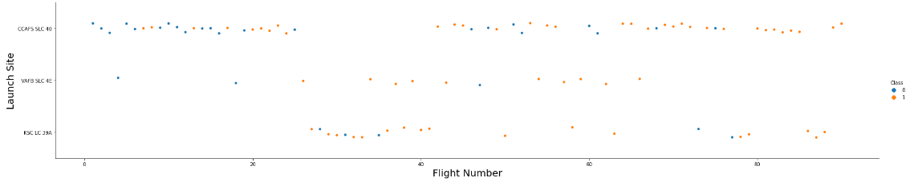
Payload vs. Launch Site
• Payloads over 9,000kg have excellent success rate;
• Payloads over 12,000kg seems to be possible only on CCAFS SLC 40 and KSC LC
39A launch sites.

Slide 22

Success Rate vs. Orbit Type
The plot indicates that ES-L1, GEO, HEO, SSO, VLEO had the most success rate.

Slide 23
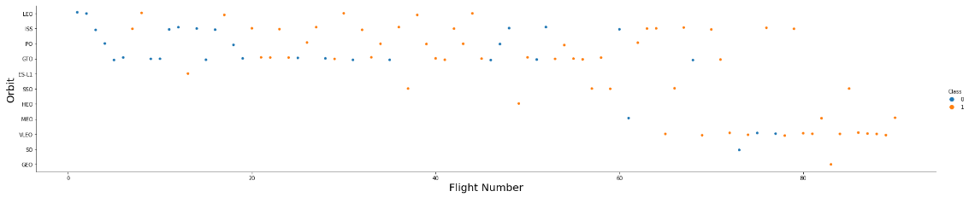
Flight Number vs. Orbit Type
The plot below shows the Flight Number vs. Orbit type. It appears that in the LEO orbit, success is related to the number of flights whereas in the GTO orbit, there is no relationship between flight number and the orbit.

Slide 24
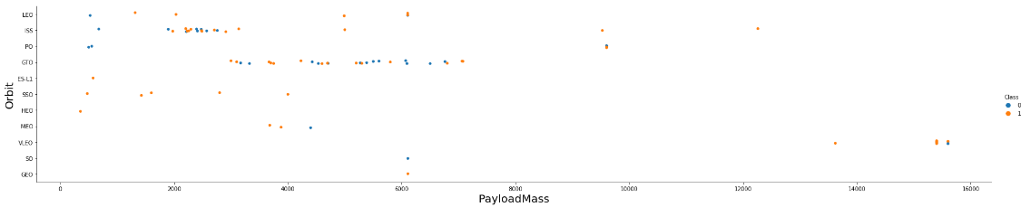
Payload vs. Orbit Type
• The relationship between payload and success rate to orbit GTO was not apparent;
• ISS orbit has the widest range of payload and a good rate of success;
• There are few launches to the orbits SO and GEO.

Slide 25

Launch Success Yearly Trend
• Success rate started increasing in 2013 and kept until 2020;
• The first three years were a period of adjusts and improvement of technology.

Slide 26

All Launch Site Names
We used the key word DISTINCT to show only unique launch sites from the SpaceX data.

Slide 27

Launch Site Names Begin with 'KSC'
The query was to present 5 records where launch sites begin with `CCA`

Slide 28

Total Payload Mass
The total payload carried by boosters from NASA as 45596 was computed using the query below.

Slide 29

Average Payload Mass by F9 v1.1
The average payload mass carried by booster version F9 v1.1 as 2928.4 was calculated

Slide 30

First Successful Ground Landing Date
The dates of the first successful landing outcome on ground pad was 22nd December 2015 were identified.

Slide 31

Successful Drone Ship Landing with Payload between 4000 and 6000
We used the WHERE clause to filter for boosters which have successfully landed on drone ship and applied the AND condition to determine successful landing with payload mass greater than 4000 but less than 6000

Slide 32

Total Number of Successful and Failure Mission Outcomes
Wildcard like ‘%’ was used to filter for WHERE MissionOutcome was a success or a failure.

Slide 33

Boosters Carried Maximum Payload
Determining the booster that have carried the maximum payload using a subquery in the WHERE clause and the MAX() function.
List the names of the booster which have carried the maximum payload mass

Slide 34

2015 Launch Records
We used a combinations of the WHERE clause, LIKE, AND, and BETWEEN conditions to filter for failed landing outcomes in drone ship, their booster versions, and launch site names for year 2015

Slide 35

Rank Landing Outcomes Between 2010-06-04 and 2017-03-20
Selecting Landing outcomes and the COUNT of landing outcomes from the data and used the WHERE clause to filter for landing outcomes BETWEEN 2010-06-04 to 2010-03-20.
Using the GROUP BY clause to group the landing outcomes and the ORDER BY clause to order the grouped landing outcome in descending order.
Rank the count of successful landing_outcomes between the date 2010-06-04 and 2017-03-20 in descending order

Slide 36

Section 3

Slide 37
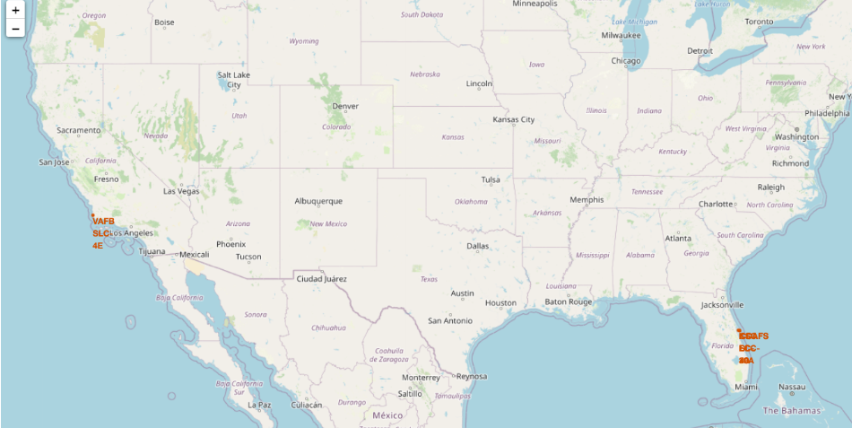
All launch sites
Launch sites are near sea, probably by safety, but not too far from roads and railroads.

Slide 38
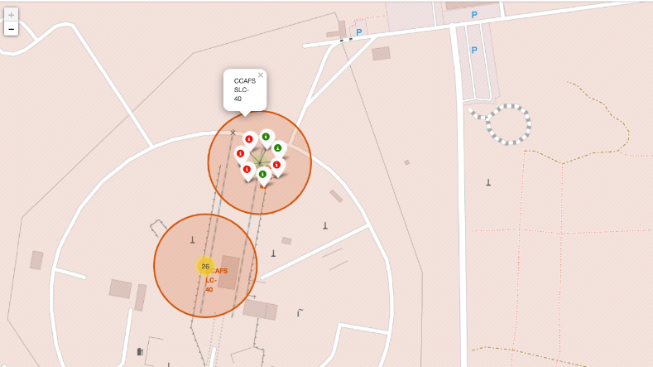
Markers showing successful and failure launches
Green markers indicate successful Launces and Red markers failure ones.

Slide 39
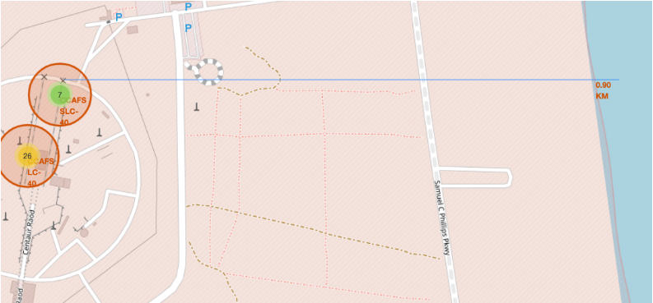
Launch Site distance to landmarks

Slide 40

Section 4

Slide 41
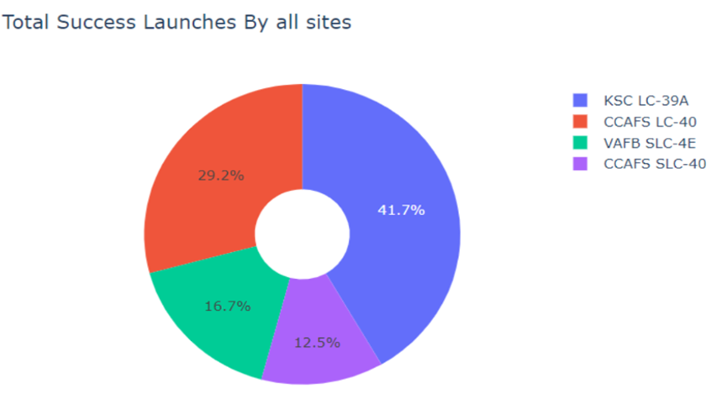
Pie chart showing the success percentage achieved by each launch site

Slide 42
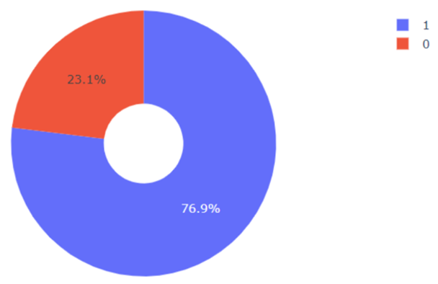
Pie chart showing the Launch site with the highest launch success ratio
This pie chart shows KSC LC-39A with 76.9% success rate (blue) and 23.1% failure (red)

Slide 43
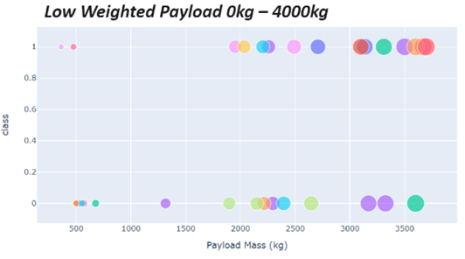
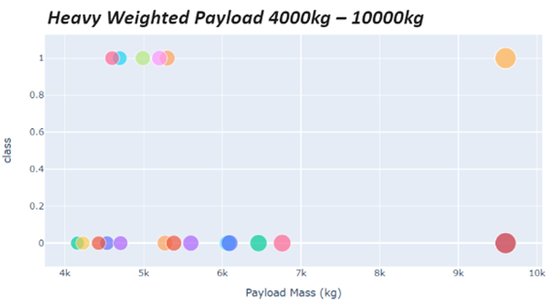
Scatter plot of Payload vs Launch Outcome for all sites, with different payload selected in the range slider
Success rate for low weighted payload is higher than heavy ones

Slide 44

Section 5

Slide 45
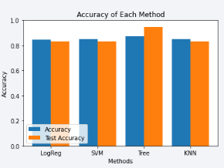
Classification Accuracy
Four classification models were tested,
and their accuracies are plotted beside;
The model with the highest classification
Accuracy, over than 87%, is Decision Tree Classifier

Slide 46
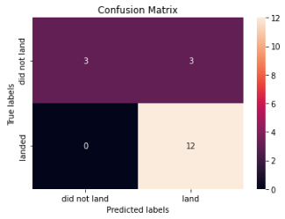
Confusion Matrix
Confusion matrix of Decision Tree Classifier proves its accuracy by showing the big numbers of true positive and true negative compared to the false ones.

Slide 47
Conclusions
The larger the flight amount at a launch site, the greater the success rate at a launch site.
Orbits ES-L1, GEO, HEO, SSO, VLEO had the most success rate.
KSC LC-39A had the most successful launches of any sites.
Successful landing outcomes seem to improve over time, according the evolution of processes and rockets;
The Decision tree classifier is the best machine learning algorithm for this task.

Slide 48
Appendix
All links of notebook presented in this report are provided in this repository
https://github.com/unyil01/edx-IBM-capstone

Slide 49


